Slide 1
PIA 3121
1 September 2026
Tools of Analysis /
Foundational Concepts

Slide 2
Objectives of PIA 3121
To introduce you to the “root discourses” of International Relations, the discipline;

Slide 3
Objectives of PIA 3121
To introduce you to the “root discourses” of International Relations, the discipline;
To use concepts developed by contributors to the root discourses to illuminate certain real-life problems and issues facing the world today.

Slide 4
The “root discourses” of IR
Realism
Liberalism
Neorealism and Neoliberalism
Economic Structuralism
The English School
Constructivism
Psychology and Ontological Security
Critical Theory
Gender and IR

Slide 5
Some real-life global problems
Systemic adjustment to the rises of China and India: fate of the liberal international order; democracy and democratization
Demography, natural resources, climate change, pandemics, existential risks
Challenges to the world political economy; technology and global communication; AI
Women and gender (in)equality; other forms of (in)equality; ethnic relations; religion in IR
Regional inter-state tensions; wars; civil wars; terrorism; revolution
Ethics and values in a multicultural world; global governance

Slide 6


Required and recommended books for PIA 3121

Slide 7
PIA 3121 Schedule
1 Sept: Tools of Analysis / Foundational Concepts
8 Sept: Realism
15 Sept: Liberalism
22 Sept: Neorealism and Neoliberalism
29 Sept: Economic Structuralism and Globalization
6 Oct: Constructivism
13 Oct: MIDTERM QUIZ
20 Oct: Ontological Security Theory
27 Oct: The English School
3 Nov: Democratization / Global Culture / Revolution
10 Nov: Critical Theory / Gender in IR / Global Civil Society
17 Nov: Chaos and Complexity in IR / Existential Risks
24 Nov: FINAL QUIZ DUE / Discussion of Group Projects
8 Dec: GROUP PAPER PROJECT DUE

Slide 8
PIA 3121 Reading Assignment for
Tuesday, 8 September 2026
Viotti and Kauppi, International Relations Theory, chapter on “Realism: The State and Balance of Power,” pp. 21-62.
Lake, David A. “The State and International Relations.” In Reus-Smit and Snidal, eds., The Oxford Handbook of International Relations, pp. 41-61.
Wohlforth, William C. “Realism.” In Reus-Smit and Snidal, eds., The Oxford Handbook of International Relations, pp. 131-149.

Slide 9
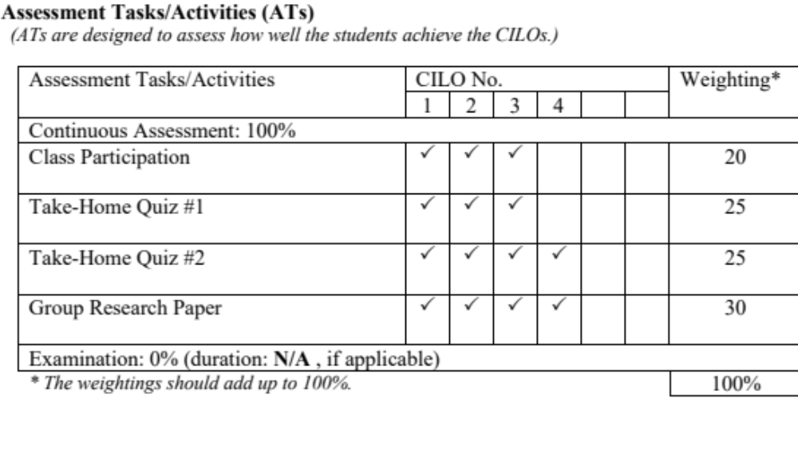
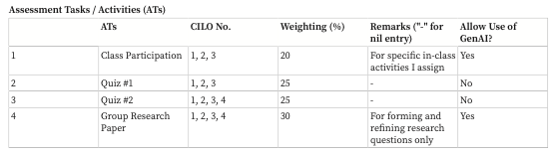
PIA 3121 final course grade calculations
Assessment Tasks/Activities (ATs)
(ATs are designed to assess how well the students achieve the CILOs.)

Slide 10

Step 1: Go to https://posit.co/download/rstudio-desktop/
Step 2: Install R
Step 3: Install RStudio

Slide 11
Articles Mentioning “National Rejuvenation” (民族复兴) in the People’s Daily

Slide 12
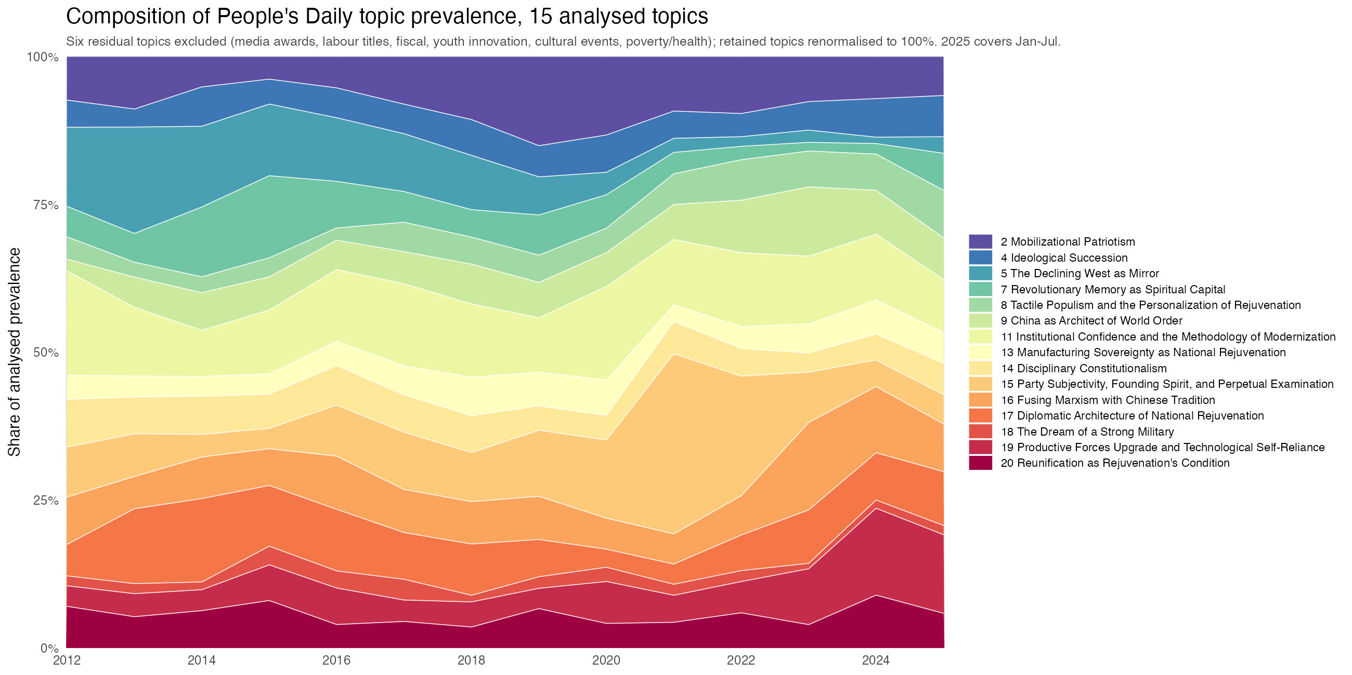

Slide 13
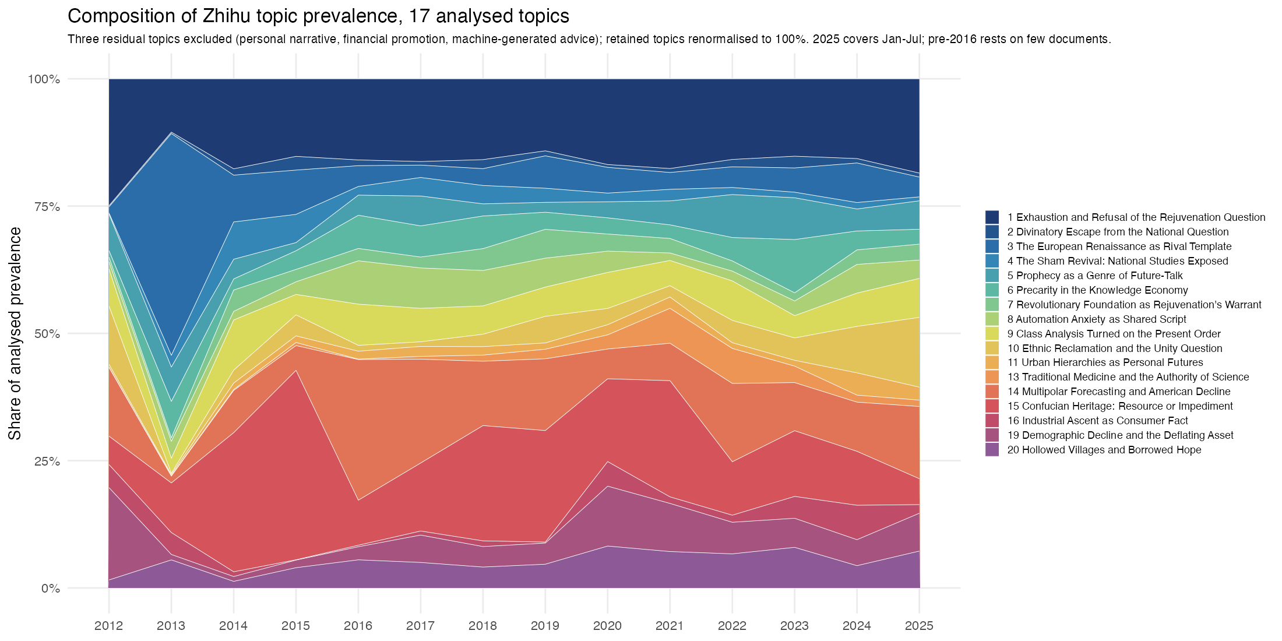

Slide 14
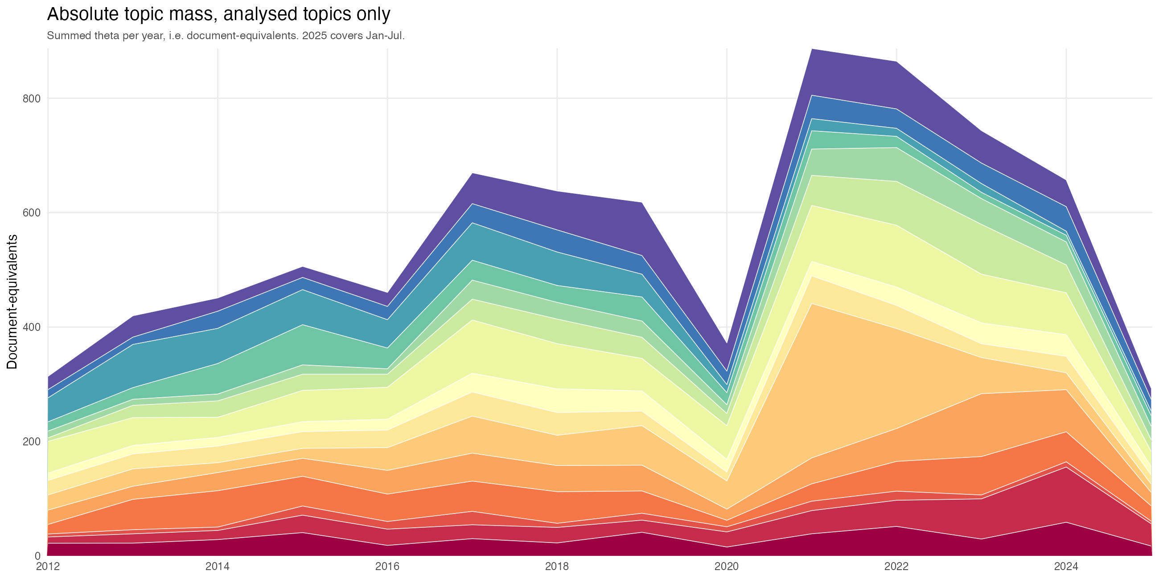
People’s Daily, rejuvenation + future

Slide 15
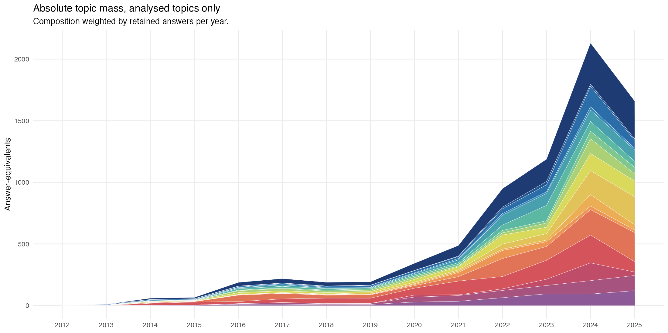
Zhihu, rejuvenation + future

Slide 16
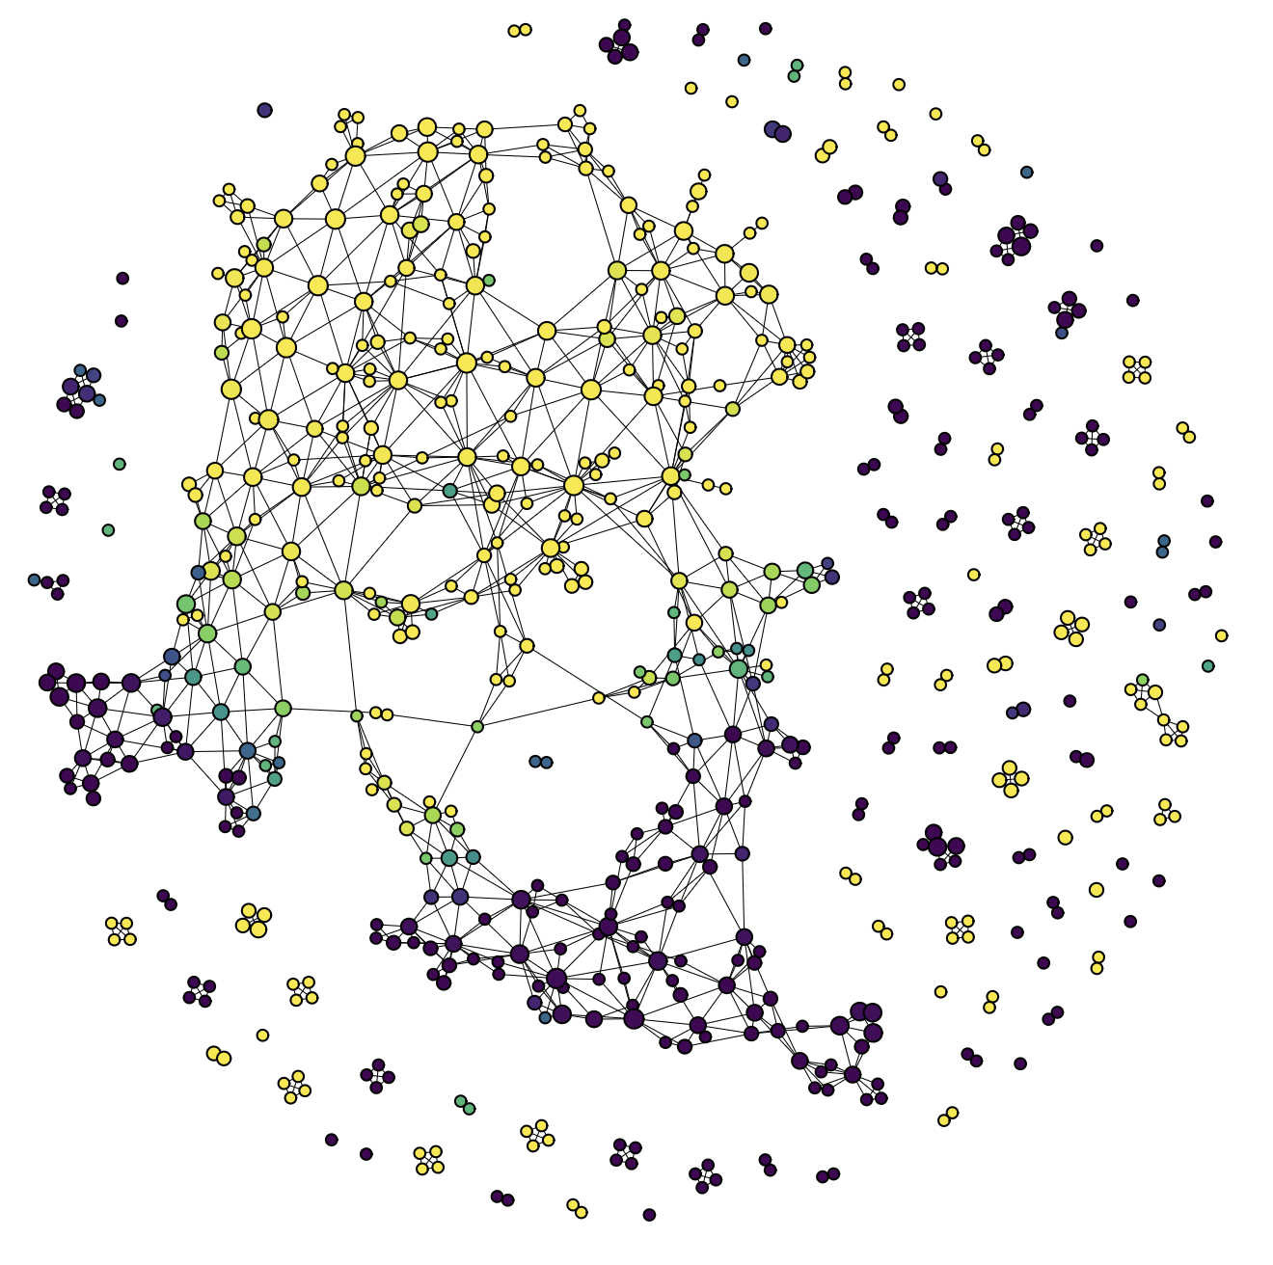
Mapper:
PD = yellow, ZH = purple

Slide 17
How AI Will Help You Create the STM in R Studio
The interaction would be a dialogue. We (AI) would guide a student through the distinct phases of the project:

Slide 18
How AI Will Help You Create the STM in R Studio
The interaction would be a dialogue. We (AI) would guide a student through the distinct phases of the project:
Setup and Installation: We can provide the code to install and load the necessary R packages (stm, quanteda, pdftools, etc.).
Text Extraction: We can generate a script to read all 500 PDFs from a specific folder and convert them into usable text.
Data Cleaning and Pre-processing: We can provide code to create the corpus, tokenize the text, remove stopwords and punctuation, and generate the final document-feature matrix (DFM).
Model Fitting: We can show the student the command to run the stm() function, explaining key parameters like K(the number of topics).
Analysis and Visualization: We can provide the code to extract and visualize the results, such as creating topic word clouds or plotting how topic prevalence correlates with metadata (e.g., news source).

Slide 19
How AI Will Help You Create the STM in R Studio
## An Example Interaction
Here’s a realistic example of what a student's conversation with me might look like:
Student:
"Okay, I've managed to extract all the text from my PDFs using the pdftools package. Now I have a list of 500 texts in R. How do I get this ready for the stm package?”
AI:
"Excellent. The next step is to use the quanteda package to convert your list of texts into a corpus and then create a document-feature matrix (DFM). quanteda cleans the data and gets it into the 'spreadsheet' format that stm needs.
Here is the R code to do that:"

Slide 20
How AI Will Help You Create the STM in R Studio
# Make sure you have quanteda installed and loaded
# install.packages("quanteda")
library(quanteda)
# Assuming your text is in a list called 'all_texts'
# First, create a corpus object.
my_corpus <- corpus(all_texts)
# Now, create the DFM, applying several pre-processing steps at once
my_dfm <- dfm(my_corpus,
remove_punc = TRUE, # Remove punctuation
remove = stopwords("en"), # Remove common English "stopwords"
stem = TRUE, # Stem words to their root (e.g., "running" -> "run")
remove_numbers = TRUE) # Remove numbers
# This DFM object, 'my_dfm', is now ready to be used by the stm package.
print(my_dfm) # You can inspect the DFM to see its dimensions

Slide 21
How AI Will Help You Create the STM in R Studio
## The Crucial Role of the Student
Even though we [the AI] can provide all the code, the student remains the research director. Our role is that of a technical assistant, not an intellectual replacement. The student still has to perform the critical thinking tasks that the AI cannot:
1. Define the research question.
2. Select and justify the text corpus.
3. Make crucial modeling decisions, like choosing the number of topics (K).
4. Interpret and label the topics based on their content.
5. Perform the final, nuanced analysis that connects the model's output back to the international relations theories discussed in your class.
6. So, while we [the AI] can write the code, the student is still required to do the driving. This makes the assignment a powerful exercise in critical analysis, using AI as the exact kind of productivity-enhancing tool they will encounter in their careers.

Slide 22
Step 1: Go to https://posit.co/download/rstudio-desktop/
Step 2: Install R
Step 3: Install RStudio

Slide 23
Why You Need Theory: Signal vs. Noise

Slide 24
Why You Need Theory: Signal vs. Noise
Drowning in Data, Starving for Insight. You are bombarded daily by pundits, algorithms, and state-sponsored narratives. The noise-to-signal ratio is overwhelming.

Slide 25
Why You Need Theory: Signal vs. Noise
Drowning in Data, Starving for Insight. You are bombarded daily by pundits, algorithms, and state-sponsored narratives. The noise-to-signal ratio is overwhelming.
The "Hot Take" Economy Will Fail You. Surface-level news analysis prioritizes immediacy and emotion over structural understanding. They tell you what happened, but rarely why.

Slide 26
Why You Need Theory: Signal vs. Noise
Drowning in Data, Starving for Insight. You are bombarded daily by pundits, algorithms, and state-sponsored narratives. The noise-to-signal ratio is overwhelming.
The "Hot Take" Economy Will Fail You. Surface-level news analysis prioritizes immediacy and emotion over structural understanding. They tell you what happened, but rarely why.
Events are Symptoms, Not the Disease. Why are semiconductor supply chains the new frontline? Why is the South China Sea militarized? Focusing only on the latest crisis blinds you to the underlying forces driving it.

Slide 27
Why You Need Theory: Signal vs. Noise
Drowning in Data, Starving for Insight. You are bombarded daily by pundits, algorithms, and state-sponsored narratives. The noise-to-signal ratio is overwhelming.
The "Hot Take" Economy Will Fail You. Surface-level news analysis prioritizes immediacy and emotion over structural understanding. They tell you what happened, but rarely why.
Events are Symptoms, Not the Disease. Why are semiconductor supply chains the new frontline? Why is the South China Sea militarized? Focusing only on the latest crisis blinds you to the underlying forces driving it.
Everyone Uses Theory. Being "pragmatic" often just means using an unconscious, outdated theory. We are here to make those theories conscious, rigorous, and powerful.

Slide 28
Why You Need Theory: Signal vs. Noise
Drowning in Data, Starving for Insight. You are bombarded daily by pundits, algorithms, and state-sponsored narratives. The noise-to-signal ratio is overwhelming.
The "Hot Take" Economy Will Fail You. Surface-level news analysis prioritizes immediacy and emotion over structural understanding. They tell you what happened, but rarely why.
Events are Symptoms, Not the Disease. Why are semiconductor supply chains the new frontline? Why is the South China Sea militarized? Focusing only on the latest crisis blinds you to the underlying forces driving it.
Everyone Uses Theory. Being "pragmatic" often just means using an unconscious, outdated theory. We are here to make those theories conscious, rigorous, and powerful.
The Goal: Cognitive Supremacy. To win, you have to develop the ability to cut through the noise, identify the actual signals of change, and achieve an independent understanding of the world.

Slide 29
The Algorithmic Society
The reorganization of social institutions is increasingly driven by algorithms, which are defined as sets of instructions written as code and run on computers.
A new "coding elite" has consolidated immense cultural, political, and economic power through their mastery of computational techniques and their ownership claims over the digital means of production.

Slide 30
The Algorithmic Society
The reorganization of social institutions is increasingly driven by algorithms, which are defined as sets of instructions written as code and run on computers.
A new "coding elite" has consolidated immense cultural, political, and economic power through their mastery of computational techniques and their ownership claims over the digital means of production.
Computer code fundamentally functions as a form of law; it translates the world into machine-readable entities and automatically enforces rules, exclusions, and resource allocations.

Slide 31
The Algorithmic Society
The reorganization of social institutions is increasingly driven by algorithms, which are defined as sets of instructions written as code and run on computers.
A new "coding elite" has consolidated immense cultural, political, and economic power through their mastery of computational techniques and their ownership claims over the digital means of production.
Computer code fundamentally functions as a form of law; it translates the world into machine-readable entities and automatically enforces rules, exclusions, and resource allocations.
Algorithmic classifiers continually extract behavioral trace data to construct surveillant "data doubles" of individuals.
The inability of individuals to shape the terms of this algorithmic dominion or evade the rule of the code raises profound questions regarding human autonomy and democratic governance.

Slide 32
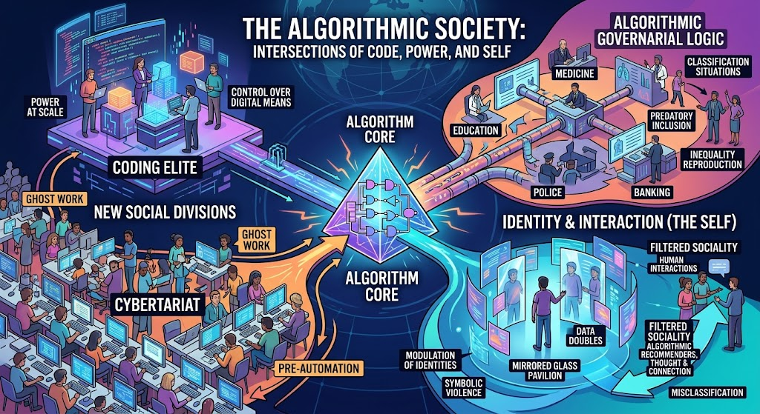

Slide 33
Cultivating “Cognitive Supremacy” in the Age of AI

Slide 34
Cultivating “Cognitive Supremacy” in the Age of AI
Geopolitical Literacy is Your Competitive Advantage. Whether you are heading into IR analysis itself (like in government), business, tech, law, journalism, whatever, the ability to assess international risk and opportunity is now a core competency.

Slide 35
Cultivating “Cognitive Supremacy” in the Age of AI
Geopolitical Literacy is Your Competitive Advantage. Whether you are heading into IR analysis itself (like in government), business, tech, law, journalism, whatever, the ability to assess international risk and opportunity is now a core competency.
The "AI-Proof" Skillset. As AI automates routine analysis, the highest value is placed on deep, critical, and strategic thinking. IR theory cultivates this higher-order cognition.

Slide 36
Cultivating “Cognitive Supremacy” in the Age of AI
Geopolitical Literacy is Your Competitive Advantage. Whether you are heading into IR analysis itself (like in government), business, tech, law, journalism, whatever, the ability to assess international risk and opportunity is now a core competency.
The "AI-Proof" Skillset. As AI automates routine analysis, the highest value is placed on deep, critical, and strategic thinking. IR theory cultivates this higher-order cognition.
Anticipating the Next Move. This course trains you to see around corners. While others focus on what is happening, you will understand why and what is likely to happen next.

Slide 37
Cultivating “Cognitive Supremacy” in the Age of AI
Geopolitical Literacy is Your Competitive Advantage. Whether you are heading into IR analysis itself (like in government), business, tech, law, journalism, whatever, the ability to assess international risk and opportunity is now a core competency.
The "AI-Proof" Skillset. As AI automates routine analysis, the highest value is placed on deep, critical, and strategic thinking. IR theory cultivates this higher-order cognition.
Anticipating the Next Move. This course trains you to see around corners. While others focus on what is happening, you will understand why and what is likely to happen next.
Navigating Uncertainty with Confidence. We can't give you a crystal ball, but we will provide the frameworks to analyze ambiguity, assess risk, and make informed decisions in a world of volatility.

Slide 38


Slide 39
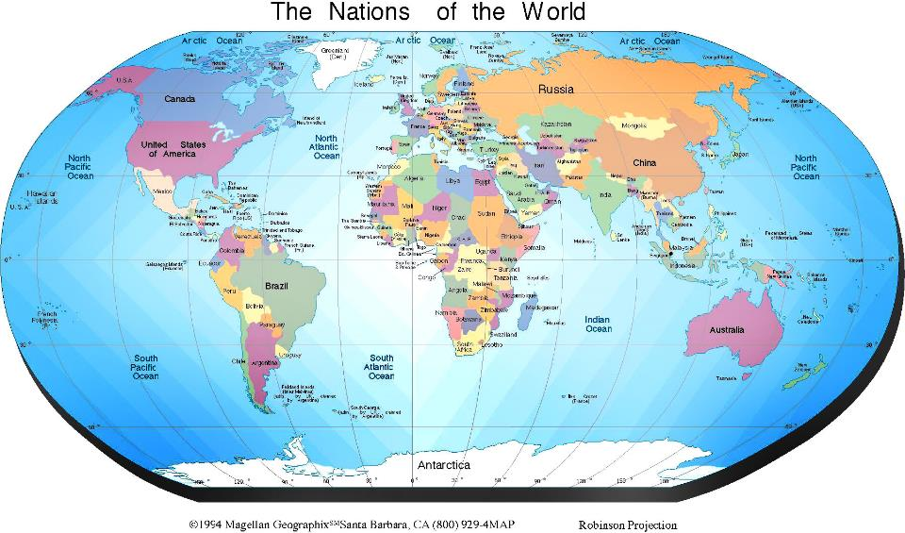

Slide 40
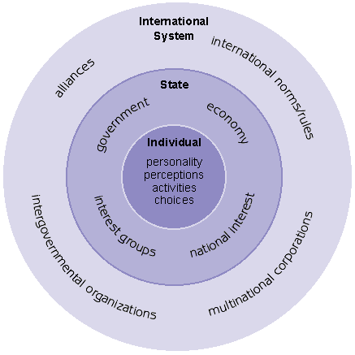

Slide 41
ANARCHY!

Slide 42
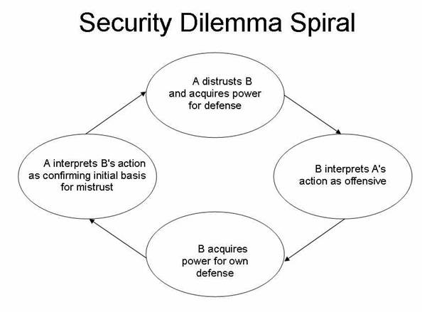

Slide 43
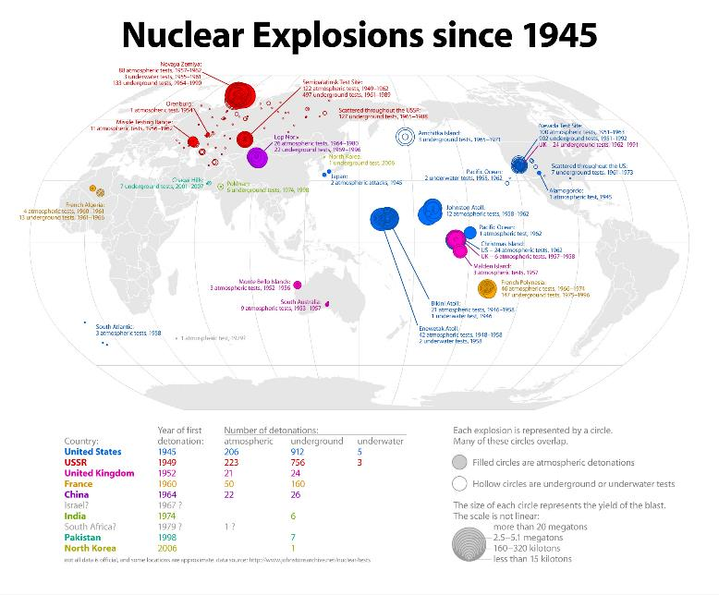

Slide 44
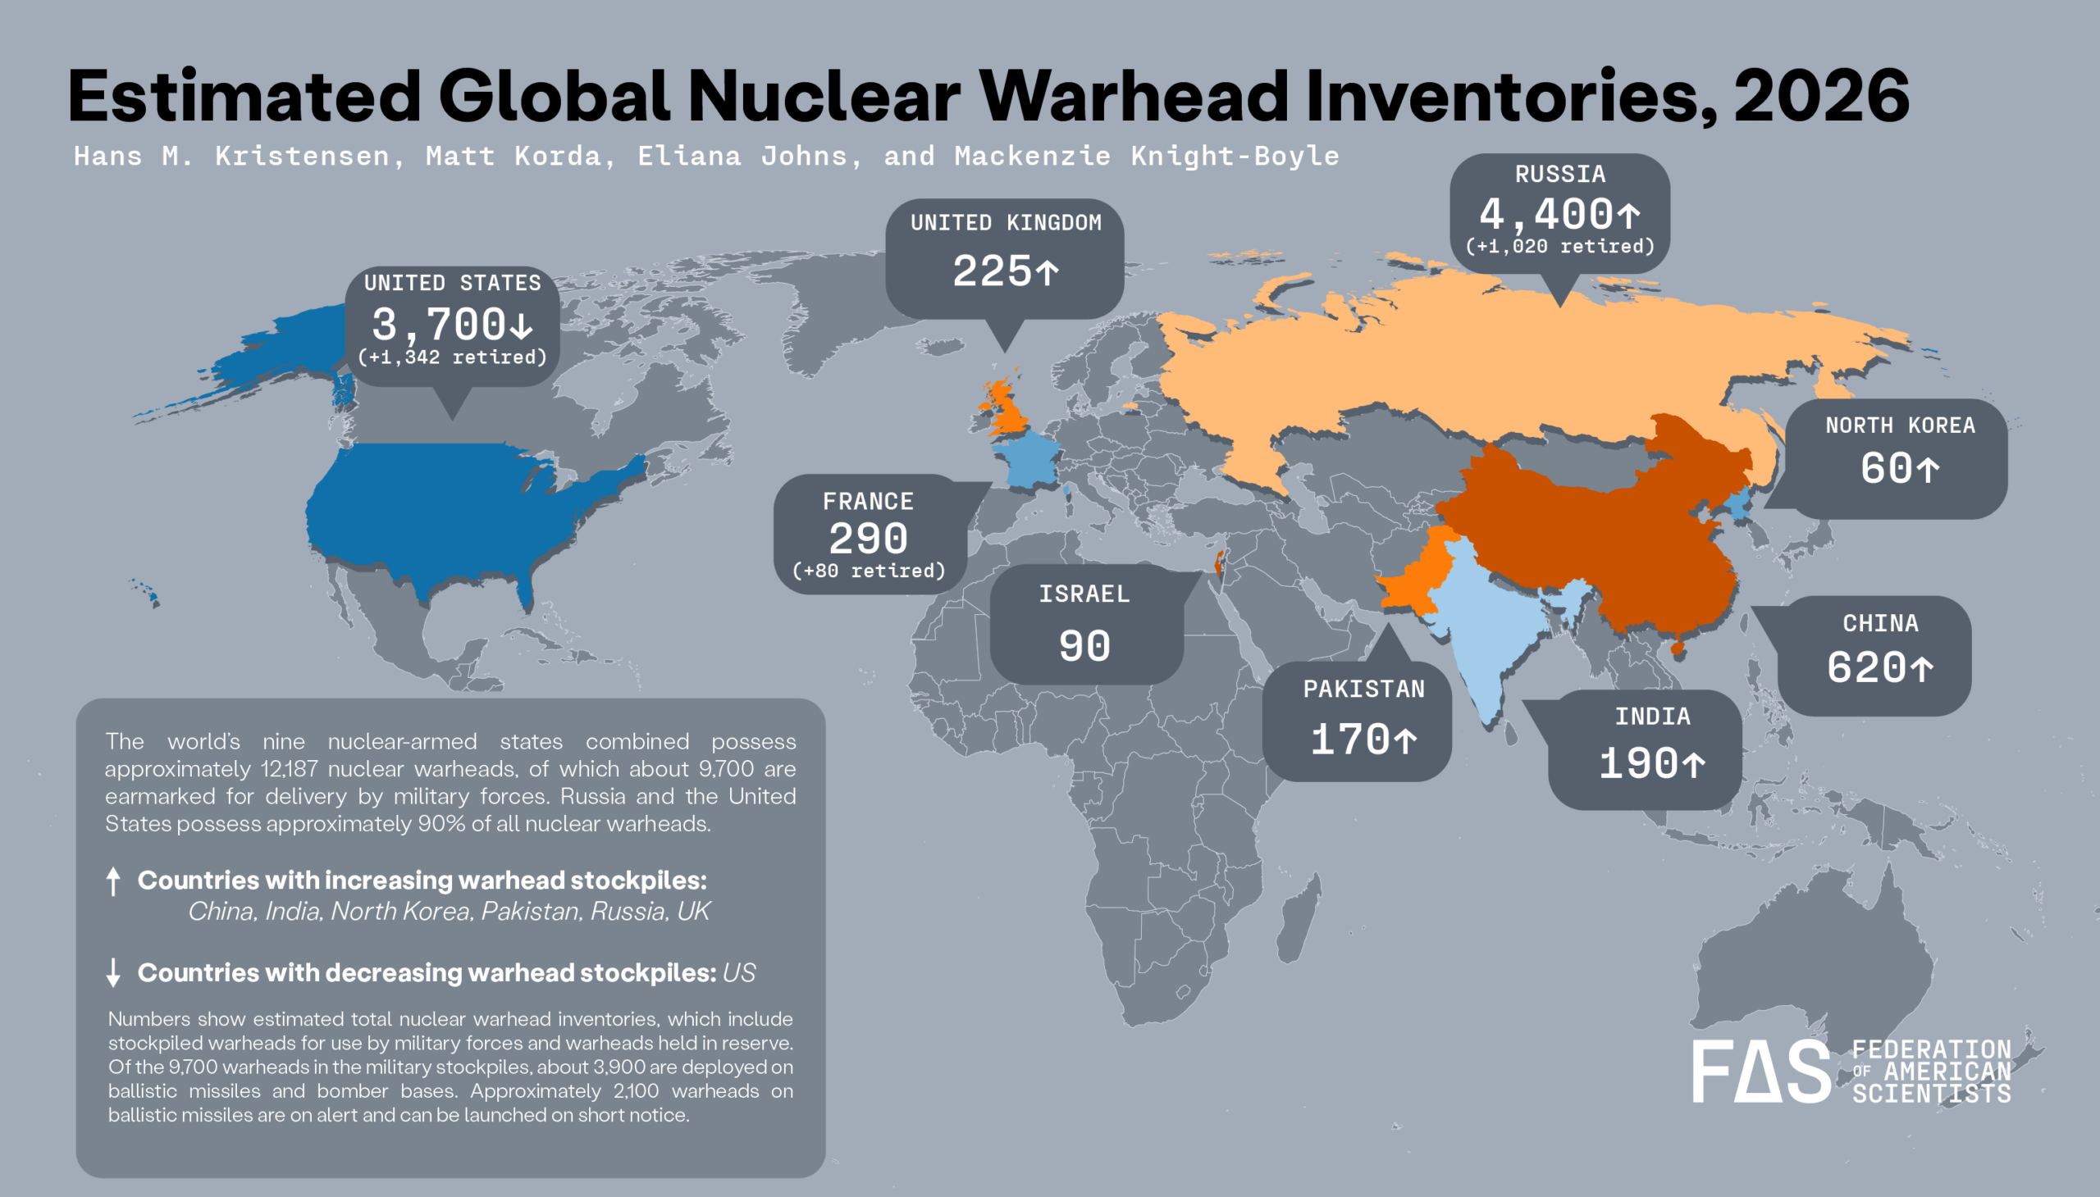

Slide 45
The 5 Sectors: Lenses for Analysis
Military
Political
Economic
Socio-Cultural
Environmental

Slide 46
The 5 Sectors: Lenses for Analysis
1. Military: relationships of forceful coercion, and the ability of actors to fight wars with each other.

Slide 47
The 5 Sectors: Lenses for Analysis
2. Political: relationships of authority, governing status, and recognition.

Slide 48
The 5 Sectors: Lenses for Analysis
3. Economic: relationships of trade, production, and finance.

Slide 49
The 5 Sectors: Lenses for Analysis
4. Socio-Cultural: collective identity; the transmission of ideas.

Slide 50
The 5 Sectors: Lenses for Analysis
5. Environmental: the relationship between human activity and the planetary biosphere which sustains it (or not).

Slide 51
Sectoral Analysis
Type of unit (states? corporations? NGOs?)

Slide 52
Sectoral Analysis
Type of unit (states? corporations? NGOs?)
Type of interaction (warfare? trade? persuasion?)

Slide 53
Sectoral Analysis
Type of unit (states? corporations? NGOs?)
Type of interaction (warfare? trade? persuasion?)
Structure (balance of power? market? economic dependence?)

Slide 54
A Risk in Sectoral Analysis!
The observer begins to confuse the partial reality of the sector with the total reality of the whole international system.

